Slide 1
Chapter 4

Slide 2
Stable Electron Configuration
We talked previously about the Octet Rule: The goal of an atom is to somehow end up with 8 valence electrons.
You have to know how many the atom starts with first.
To quickly identify the number of valence electrons an element starts with we use electron dot diagrams.
The electron dot diagram is a model of an atom which each dot represents a valence electron.
This is also called a Lewis structure.
Electron Dot Diagram = Lewis Structure.

Slide 3
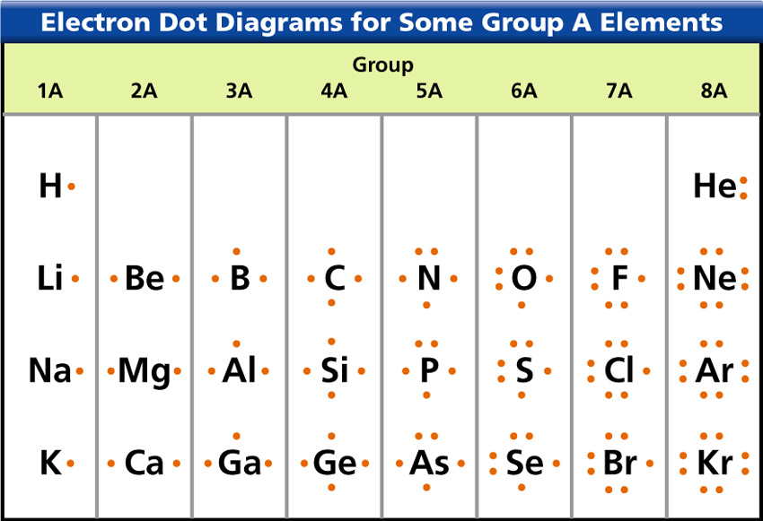
To make a Lewis Structure: The element symbol in the center represents all non-valence electrons and the nucleus.
The dots on the outside represent the valence electrons.
Valence Electron
Symbol

Slide 4
Electron Dot Diagram
Making Lewis Structures is simple, but there are things we’re assuming
The symbol represents all the protons & neutrons and all internal electrons.
You know how electrons are distributed in the atom already and what is in the nucleus though so we don’t always need to write them.

Slide 5
Lewis Dot Structures

Slide 6
Following Conventions…
There are few rules to Lewis Structures but it’s important to remember that electrons are paired in orbitals and they also spread themselves out because they are the same charge. As such, complete Lewis structures by entering valence electrons into the 12 o’clock position, moving clockwise to the 3, 6, & 9 o’clock position with every new valance electron, ending with 2 electrons paired at each position.

Slide 7
…entering valence electrons into the 12 o’clock position, moving clockwise to the 3, 6, & 9 o’clock position with every new valance electron, ending with 2 electrons paired at each position.
Valence Electrons are paired at the 12, 3, 6, & 9 o’clock positions

Slide 8
